Slide 1

Real.PPT FREE TEMPLATE #98
https://pptfree.wonjc.com

Slide 2

When you allow a thought of doubt to enter your mind, the law of attraction will soon line up one doubtful thought after another. The moment a thought of doubt comes, release it immediately. Send that thought on its way. Replace it with ”I know I am receiving now.” And feel it.

Slide 3
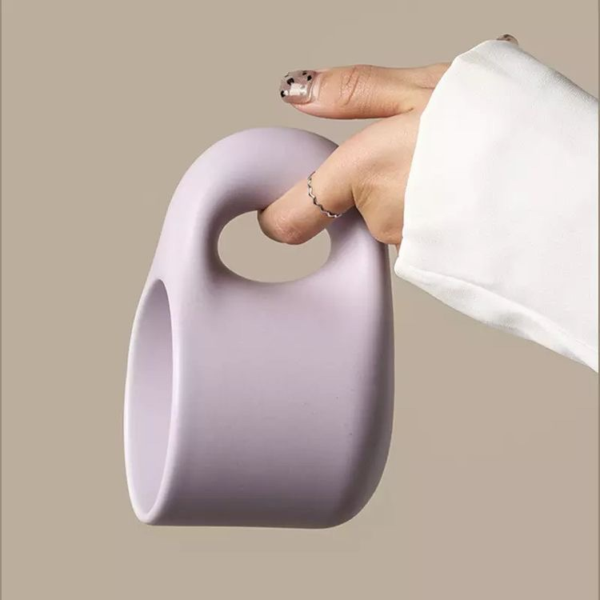
Forgive yourself for not knowing what you didn’t know until you lived through it.
48%
Honor your path. Trust your journey. Learn, grow, evolve, become.
83%
You just need to trust that what you want is coming and watch how fast it comes.
24%

Slide 4
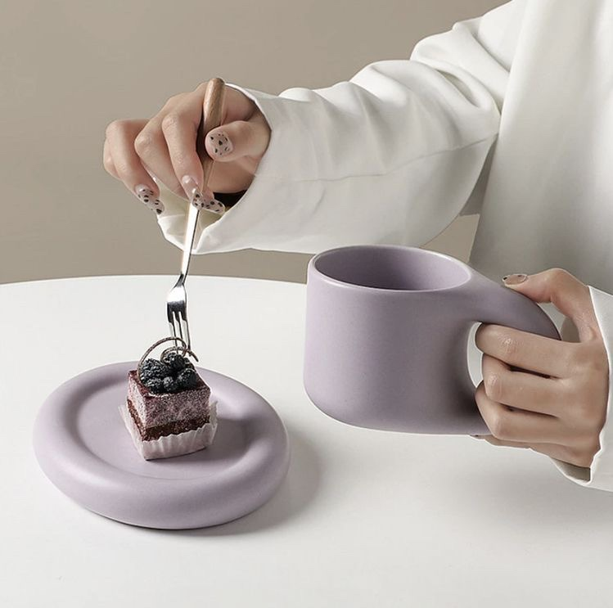
Everything you want is coming. Relax and let the universe pick the timing and the way.
If you can concentrate always on the present, you will be a happy man. Happiness is the art of never holding in your mind the memory of any unpleasant thing that has passed.

Slide 5

We must keep putting one foot in front of the other even when we hurt, for we will never know what is waiting for us just around the bend.
All of us to understand the importance of branding. We are CEOs of our own companies: Me Inc. To be on business today, our most important job is to be head marketer for the brand called you.
You are human, not perfect. You’ve been hurt, but you’re alive.
We are all storytellers.

Slide 6

Being to use the two most powerful words, I am, to your advantage, how about.
a
I am receiving every good thing. I am happy. I am abundant. I am healthy. I am loved.
b
I am always on time. I am eternal youth. I am filled with energy every single day.
c

Slide 7

When you allow a thought of doubt to enter your mind, the law of attraction will soon line up one doubtful thought after another. The moment a thought of doubt comes, release it immediately. Send that thought on its way. Replace it with ”I know I am receiving now.” And feel it.

Slide 8
THANK YOU ☺

